Slide 1
Identifying Sign Language Characters from Images
Exploratory Analysis
10/30/2015

Slide 2



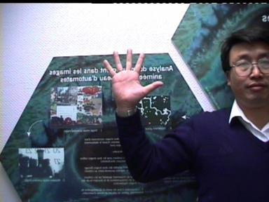


The challenge is to have computers recognize and “translate” sign language characters from diverse, complex images
The Challenge
In: Raw Sign Language Images
Out: Identified / “Translated” Characters
A
B
C
5
Point
V

Slide 3




In this exploratory analysis, we achieved ~40% accuracy, over 100% better than baseline
Results
Rank
Model
Image Processing*
1 | Ensemble Logistic + Linear SVM Fully Optimized
2 | Ensemble Logistic + Linear SVM Fully Optimized
3 | Ensemble Logistic + Linear SVM Optimized PCA + Logistic
4 | Ensemble Logistic + Linear SVM Optimized PCA
5 | Ensemble Logistic + Linear SVM with PCA
6 | Ensemble Logistic + Linear SVM
7 | Logistic Regression
8 | Logistic Regression
9 | Multinomial Naïve Bayes
10 | Random Guess

Slide 4
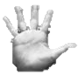
Given more time, the accuracy could be improved even further
Opportunities for Improvement
Image Processing
Neural Networks
The current best approach uses relatively little image processing
The current model could benefit greatly from better isolating the hand in the images
More fine-tuned, accurate (rule based?) skin detection
Scaling the identified hands to a consistent size
Rotating / jittering the hands
Example:
Though computationally intensive and slow to train, neural networks (specifically convolutional neural networks) are the current gold standard in many image classification problems
Hidden
Input
Output

Slide 5
Questions?
?

